Slide 1
Ground Target Following for Unmanned Aerial Vehicles
Jason Li
Jeremy Fowers

Slide 2
Agenda
Introduction
Hardware Configuration
Software Configuration
Vision-Based Ground Target Following
Target Detection
Image Tracking
Target Following Control
Experimental Results
Questions

Slide 3
A Robust Real-time Embedded Vision System on an Unmanned Rotorcraft for Ground Target Following
Feng Lin, Xiangxu Dong, Ben Chen, Kai-Yew Lum, Tong Lee
National University of Singapore
Lin, F.; Dong, X.; Chen, B. M.; Lum, K.-Y.; Lee, T. H.; , "A Robust Real-Time Embedded Vision System on an Unmanned Rotorcraft for Ground Target Following," Industrial Electronics, IEEE Transactions on , vol.59, no.2, pp.1038-1049, Feb. 2012

Slide 4
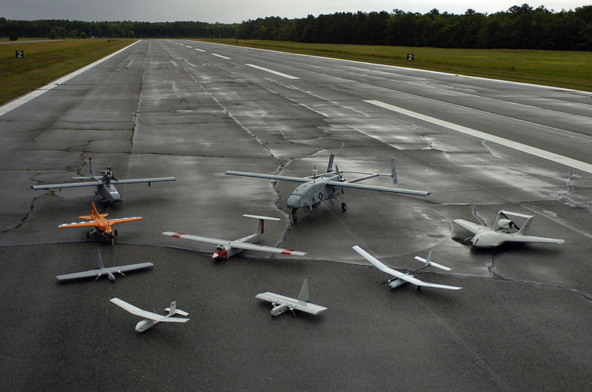
Introduction
Increasing interest in UAVs
Industrial surveillance
Agriculture
Defense and security
Vision payload
Search and rescue
Target detection and tracking
Surveillance

Slide 5
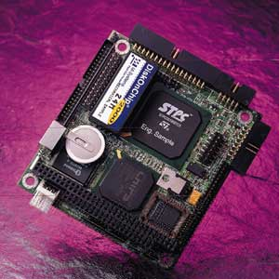
More Advanced Functions?
Applications and advancements
Vision-aided flight control
Terrain mapping
Navigation
Vision System Design/Implementation
Hardware system
Real-time software system
Mission-based vision algorithms

Slide 6
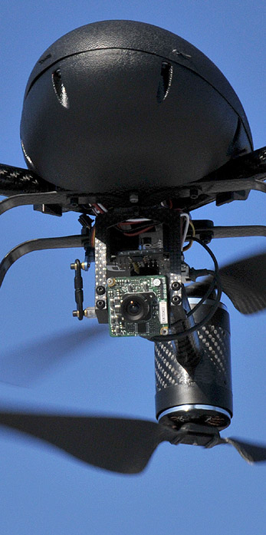
Description of Application
Autonomous Flight Control
Locates target
Tracks target
Vision feedback for flight control
Maintains relative distance

Slide 7
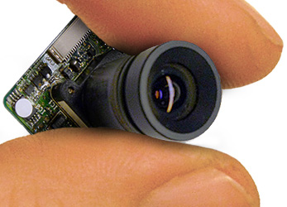
Hardware Configuration
Visual Sensor
30g, 380 TV line resolution, 40˚ field of view
Image Acquisition Module
720x576, multiple inputs, 30 FPS
Vision Processing Module
Two separate for vision and flight control

Slide 8
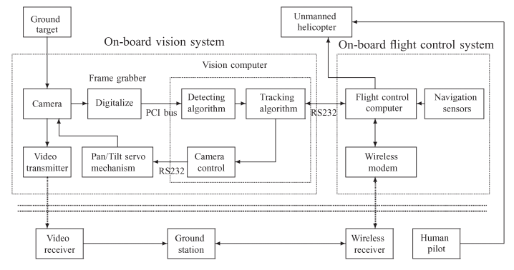
Hardware Configuration
Pan/Tilt Servo Mechanism
Wireless Data and Video Link

Slide 9
Software Configuration
Additional systems: SAV and MAIN
IMG
COM
CAM
SVO
USER

Slide 10
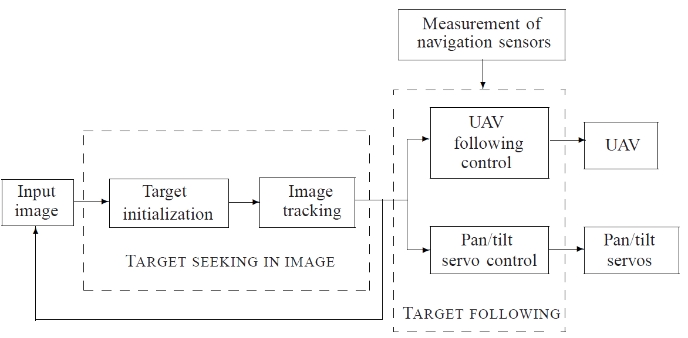
Vision-Based Target Following
Many options available
Template matching, background subtraction, optical flow, stereo vision, feature based
Authors chose feature detection + tracking
Get target position with vision + nav sensors

Slide 11
Target Following
Follow a predefined target, ie toy car
Step 1 is Target Identification
Segmentation
Feature Extraction
Pattern Recognition
Discussion tuned to Embedded Systems
Math has been glossed over
Embedded compromises highlighted

Slide 12
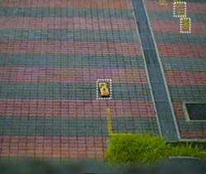
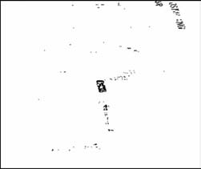
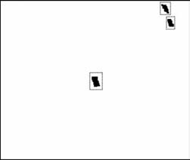
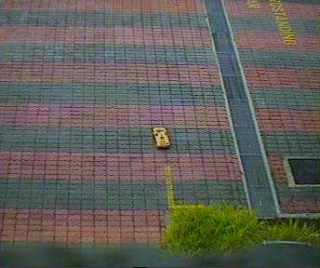
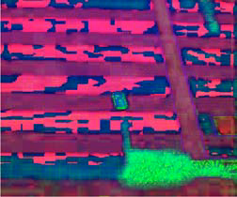
Segmentation
Separate objects from background
Assume brightness constant with viewing angle
Assume target has a distinct color distribution
Convert to hue-saturation-value
Filter by color threshold
Morphological operations
Contour Detection
Segmented Image

Slide 13
Feature Extraction
Find distinguishing characteristics in objects
Geometric Features
“Four lowest moment invariants”, “Object compactness”
Color Features
Create color histogram for each object
Dynamic Features
Distance from object to expected target location

Slide 14
Pattern Recognition
Identify target from segmented objects
Bayesian function + a priori knowledge
Pre-filter: remove objects that contradict a priori knowledge
Discriminant Function: select object with the highest probability of being the target
Takes training data, extracted features as input

Slide 15
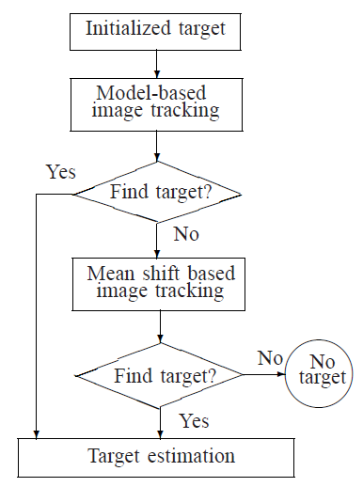
Image Tracking
Follow target through frames once identified
Hierarchical system of trackers
Only use complex if simple fails

Slide 16
Image Tracking cont.
Model-based Image Tracking
Predict location of target, estimate likelihood target is present
Low computational overhead, failure prone
Mean Shift Algorithm
Determine if the target is still in the image
More powerful, much more expensive

Slide 17
Target Following Control
Instruct the pan/tilt servo and UAV navigation
Camera is pointed to center the target
UAV maintains specified distance from target
The calculation itself is outside the scope of this lecture

Slide 18
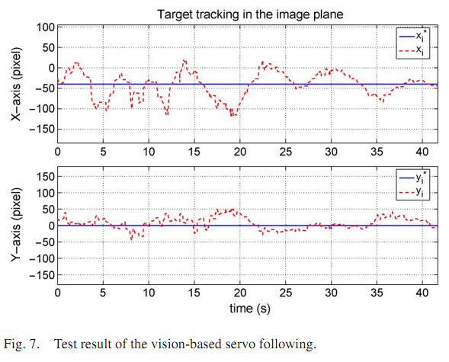
Experimental Results
Vision-based servo following

Slide 19
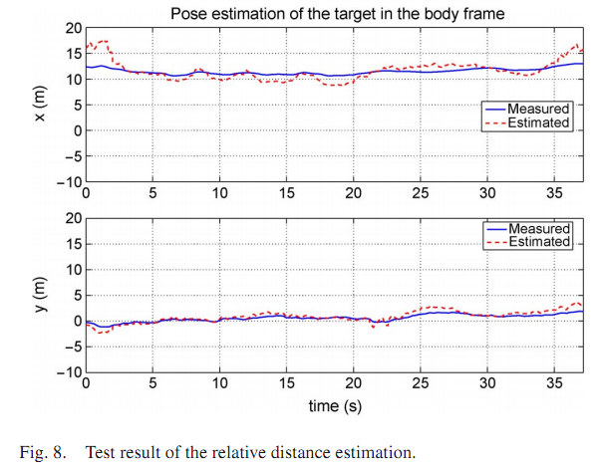
Experimental Results
Relative distance estimation

Slide 20
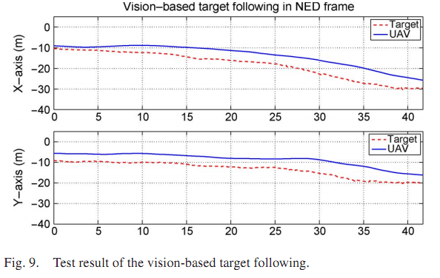
Experimental Results
Vision-based target following

Slide 21
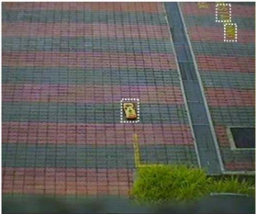
Conclusions
Design and implementation of vision system for UAV
Automatically detect and track target
Guide UAV to follow motion of target
Further research

Slide 22
Questions?

